Slide 1

GamersCoNNecT
WWW. GAMERSCONNECT.COM

Slide 2

iNTRODUCTION
Playing together is always fun.
Then, “WHY PLAY SOLO”.
Find a gamer that aligns with your style, strategy and interests.
Notes:
© Copyright Showeet.com – Free PowerPoint Templates

Slide 3
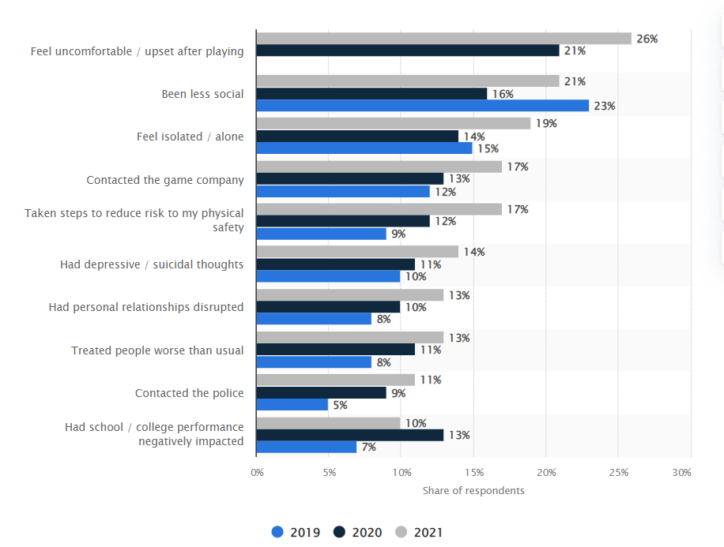
PROBLEM
Harassment Impact (Statista.com)
Playing games with your friends provide a richer experience of the game, but where to find such friends?
MATCHMAKING??
No, matchmaking only considers the progress, rank, in-game stats and platform into consideration. Also, many times you may find toxic people. 72% of the online gamers have witnessed in-game toxicity (Unity reports)
But I need someone, who can align with my gaming style, mindset, interests, timings and a great person to enjoy the gaming experience.
Notes:
© Copyright Showeet.com – Free PowerPoint Templates

Slide 4

vision
Provide a platform to all the gamers where they can find their partners they are looking for.
An app which can allow gamers filter through the different gaming platforms, genres, games, gaming style, gameplay skills, gameplay progress, timings, game characters, etc. to find their perfect partner.
Notes:
© Copyright Showeet.com – Free PowerPoint Templates

Slide 5


strategy
Provide a platform
Unique Selling Point
With number of online gamers to reach 1 Billion by 2025, we want to build a platform and invite gamers to sign-up by providing their information related to games.
To search for your gaming partner based on your requirements and filters
Strong community of gamers to share their achievements, posts, gameplay videos, questions etc. and can engage with other gamers around the world.
Guidance to make your career in gaming industry
Tips & Tricks provided by expert gamers in the communities
New trends and information of gaming industry/companies
Get updates and exclusive deals for the gaming accessories
Gaming partner – Manual search and Recommendations
Exploring gaming industry for career options
Bi-weekly podcasts with experts
Suggestion on new games
Information on gaming industry, upcoming sales, and gaming accessories

Slide 6
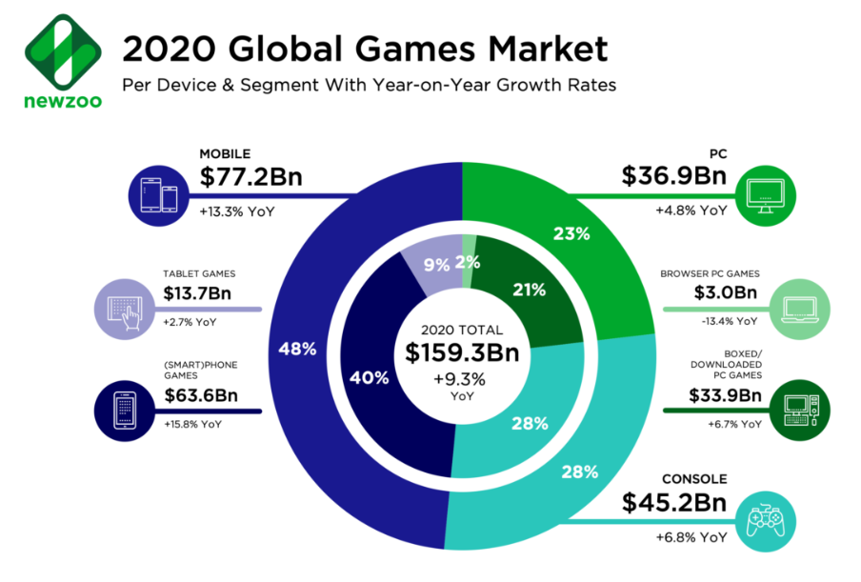
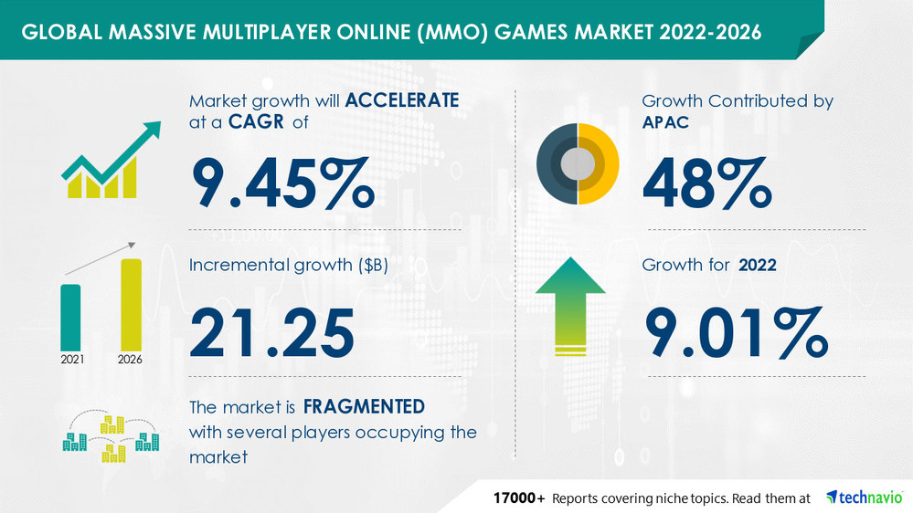

Market opportunity
Gaming Market Size Moving Upwards to Hit USD 545.98 Billion by 2028
Fortune Business Insights™
The massive multiplayer online (MMO) games market size is expected to grow by USD 21.25 bn from 2021 to 2026.
prnewswire.com
Over 1 Billion online gamers by 2025
Statista.com

Slide 7
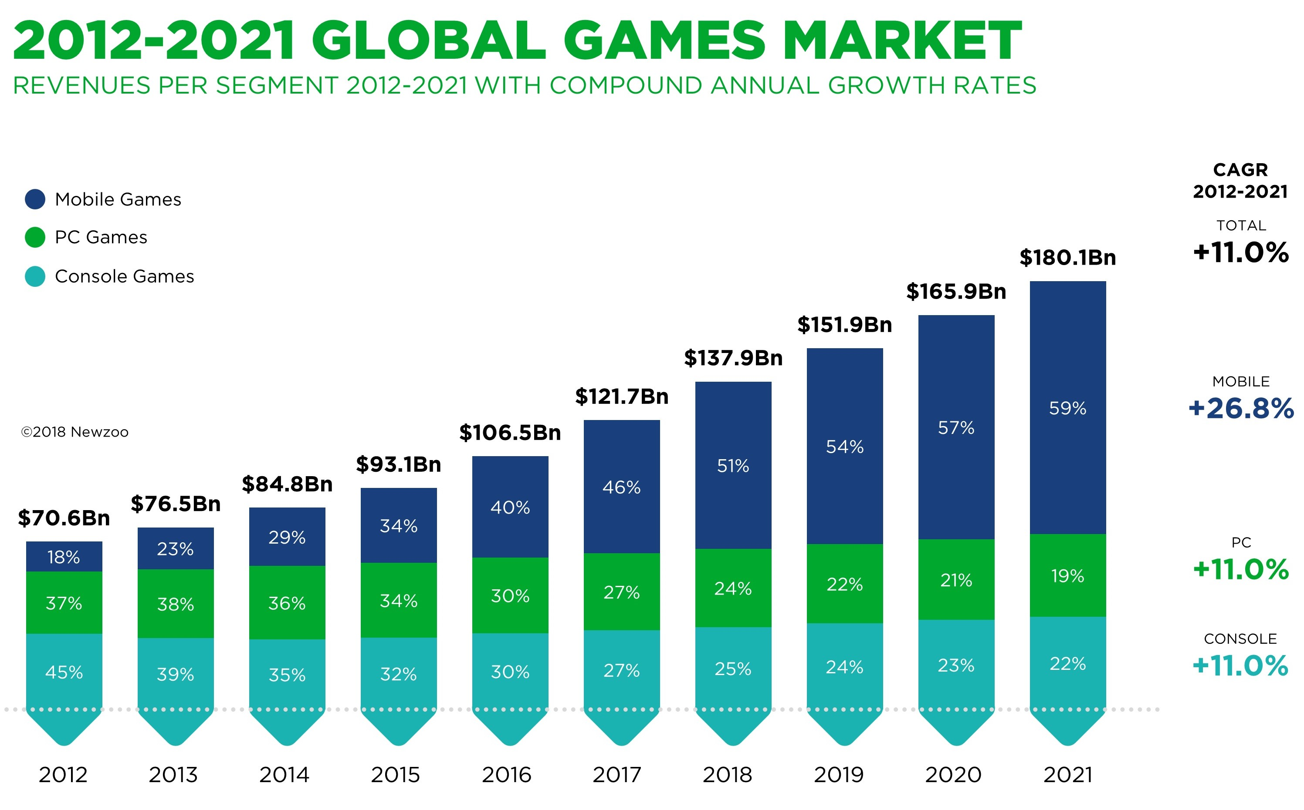
Industry Overview and Market Analysis
Industry Overview:
Improvement in Gaming Technology
Ease of access to games for users
Money generated through e-sports
The industry is to continue growing at double-digit rates annually.
Industry-wide figure is up 13.3% year-over-year, driven largely by a 25.5% jump in mobile revenues to reach $70.3 billion.

Slide 8



Discord generated $130 million revenue in 2020, an 188% increase year-on-year.
Twitch made an estimated $2.6 billion revenue in 2021, mostly from advertising with a 41% year-on-year increase.
TeamSpeak's estimated annual revenue is currently $1.5 million.

Slide 9
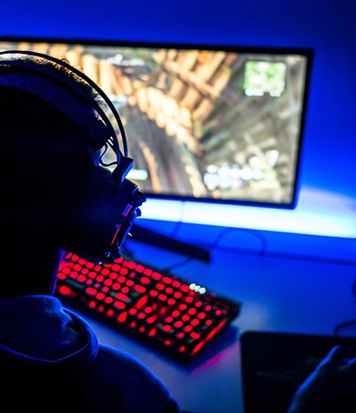
Competitive Analysis
GamersConnect’s number one competitor is “Plink”, a similar app that has failed in multiple ways. GamersConnect learns from and offers a solution to those failures.

Slide 10
Gamersconnect’s competitive advantage
Plink’s Failures
GamersConnect’s Solution
Charges customers $20 to begin to use the app for the first time
Customers hit paywall after a few hours of play which forces them to pay to use the app
Need to use Discord app to chat with friends on Console which adds extra expense for customer; Plink only usable on mobile or desktop
Weekly subscription too costly and unclear instructions for customers who may want to cancel subscription
Has a free mode where customers have limited capabilities
Option to upgrade to premium paid monthly subscription for unlimited capabilities
Integrates its own console chat feature within GamersConnect app
Clearly communicate “Cancel any time” policy; No contract

Slide 11

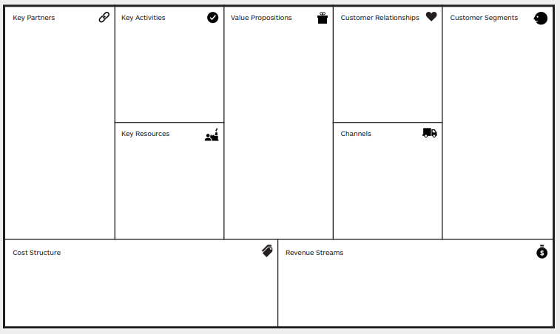
BUSINESS MODEL
Platform Management
Customer Support
More Enjoyable video gaming experience for regular and new gamers.
Career opportunities
Enhance gaming
Partner search
Podcasts
Video Game recommendations.
Gaming Retail Coupons.
Video Game Companies
Industry Professionals
Expert gamers
Gaming Retailors
Free User
Premium User
Business Account
Platform
User insights
Business account
Gamersconnect.com
Mobile App
Platform Development & management
Hiring expert gamers and industry professionals
Customer Support
Monthly Premium Subscription
Display Ad Revenue
Business accounts
Monetize user insights
Notes:
© Copyright Showeet.com – Free PowerPoint Templates

Slide 12

Marketing Plan
Product, Promotion, Pricing, Place, and more.

Slide 13
Marketing plan
January 2023 – Product R&D
Review all positive and negative reviews of competitor app, review news surrounding competitor app
Research most fruitful types of advertisements for this kind of app
Select a sample group of customers to test out and provide feedback for the app
Implement those feedbacks and address concerns or bugs
May 2023 – Pricing, Distribution, Service, & Support
Free mode with advertisements
Paid subscription for premium features
Google and Apple App Stores for mobile and desktop
December 2023 – Promotion & Placement
Social media influencers in the gaming space promoting our product
Create video ads to place on social media sites that are used most by game players
Create advertisement trigger to show up for game players who have shown interest in this type of app based on internet activity
Social media competitions to win prizes
Referral program: Get a friend to sign up for the first time and win a free month of premium subscription
Merchandise online store: hoodies, t-shirts, mugs

Slide 14
Marketing plan continued
Market Segment:
Mobile, desktop, and console gamers of all ages and skillsets
Positioning Among Competitors:
Eliminates the pressure of immediate payment requirements from the customer that was present with competitor app
Imaging:
Ability to use for free, the best social networking app for Gamers, like Tinder but for forming gaming teams
Sales Forecasts:
Projected growth of 4% YoY starting at an estimated 300K app downloads per year and expected 50% to upgrade to premium in first year

Slide 15
TIMELINE OF EVENTS
 | 1/23 | 02/23 | 3/23 | 4/23 | 5/23 | 6/23 | 7/23 | 8/23 | 9/23 | 10/23 | 11/23 | 12/23 | 1/24 | 2/24 | 3/24
Friends/Family Rounds
Seed Funding
Incorporate Business
UI Design
UX Design
Backend Development
Frontend Development
Beta Testing
Finalization and Launch
Social Media Marketing
Maintenance and Support

Slide 16


